Slide 1
Project Title:
Complaint Management Portal
PRESENTED BY:
Ayesha wahid(21-arid-561)
Aqsa mukhtar(21-arid-554)
Kanwal mumtaz(21-arid-585)

Slide 2
DESCRIPTION:
Complaint Management System Is A Project That Can Request A Complaint Through An Online Service. The System Is Easy To Operate And Manage, The User Can Sign Up For An Account And Provide Login Information Before You Send Your Complaint Request. The User Must Fill Up Some Needed Information To Start Up A Complaint To Any Topic That They're Against.
TOOLS &TECHNOLOGY:
Front End: Html/CSS jQuery using bootstrap
Backend: jQuery ,PHP
Database: MY SQL.
Tools: vscode,XAMMP.

Slide 3
FRONT END: INDEXPAGE USERREGISTERATION USERLOGIN COMPLAINT REGISTERRATION COMPLAINT DETAIL COMLAINT HISTORY

Slide 4
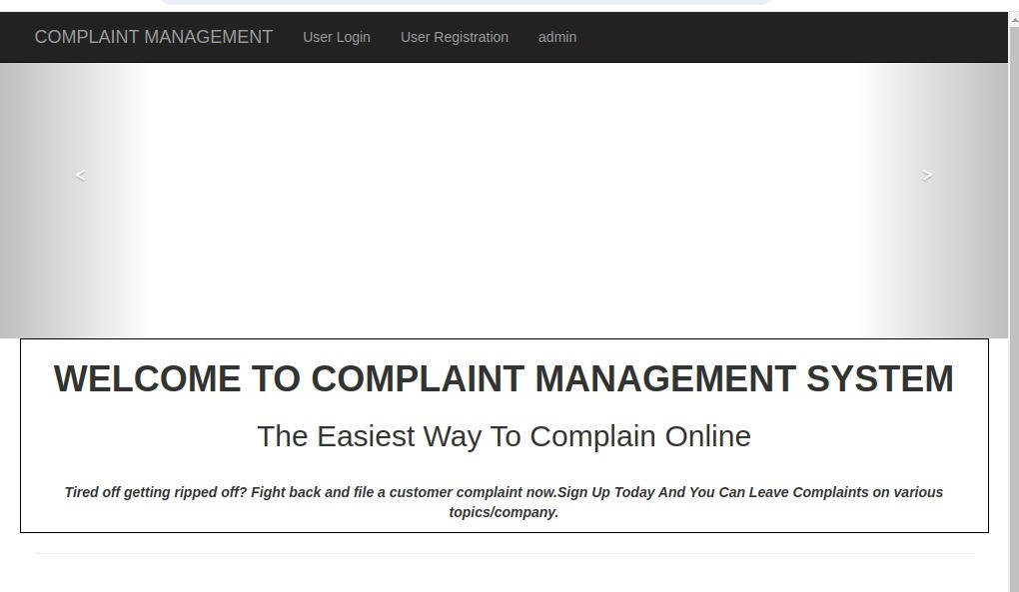
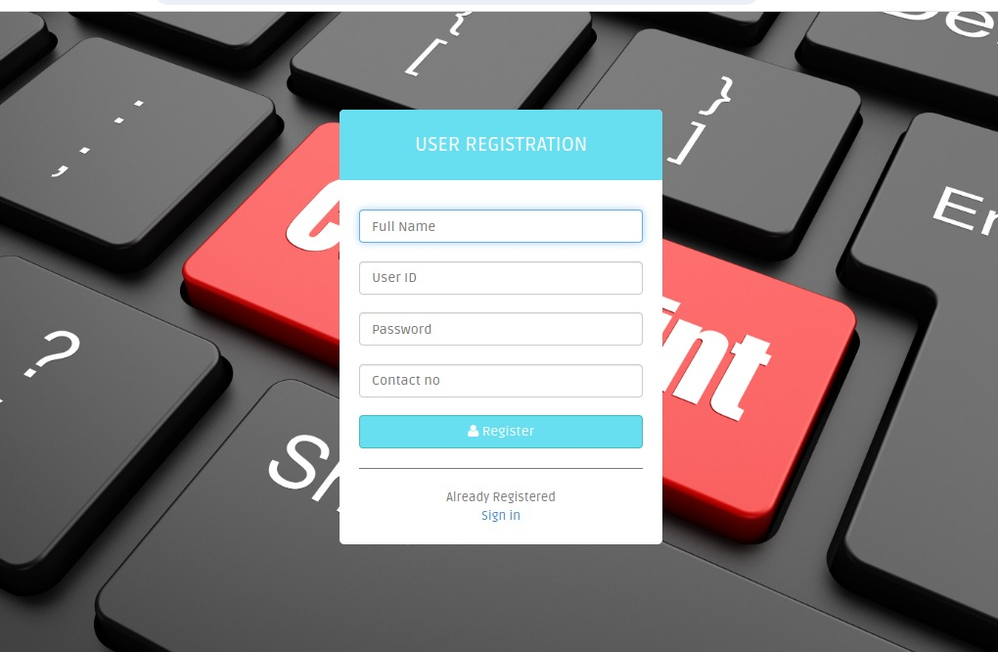
INDEX PAGE & REGISTERATION PAGE:

Slide 5
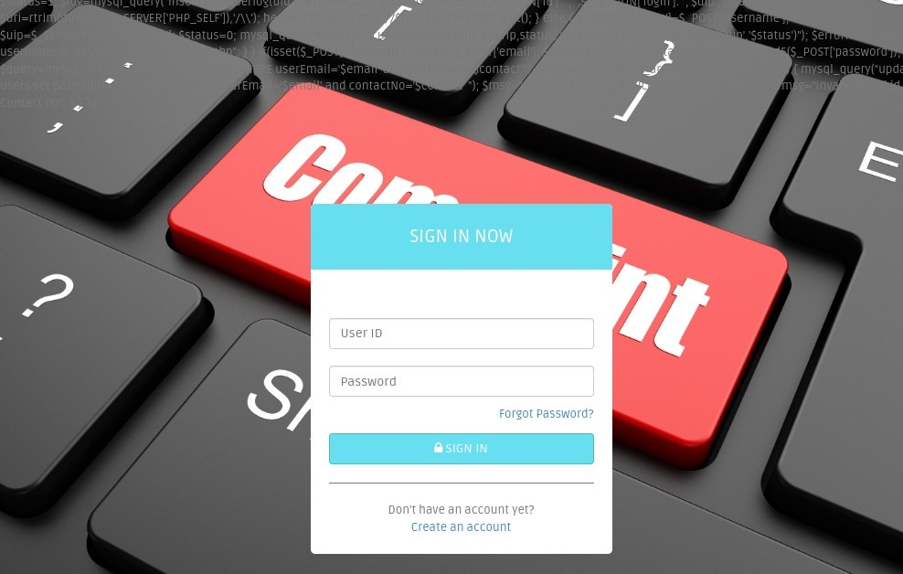
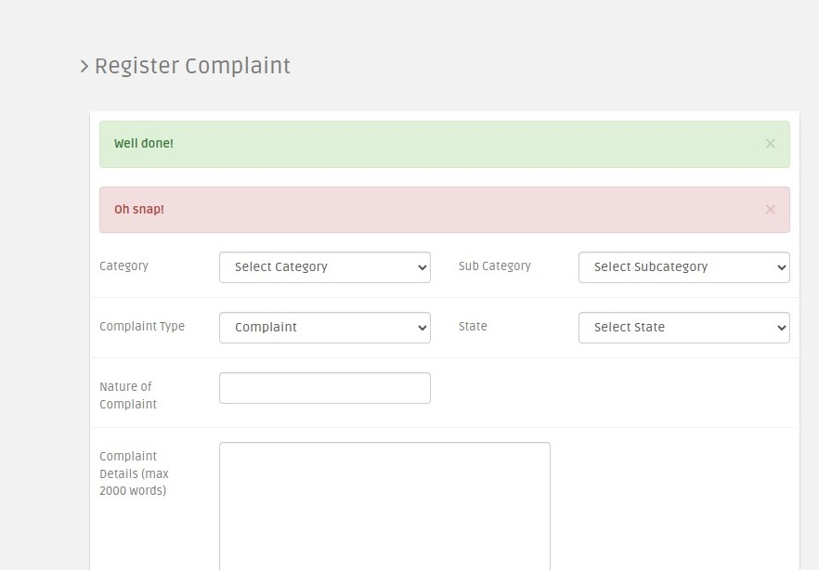
USER LOGIN &COMPLAINT REGISTERATION:

Slide 6
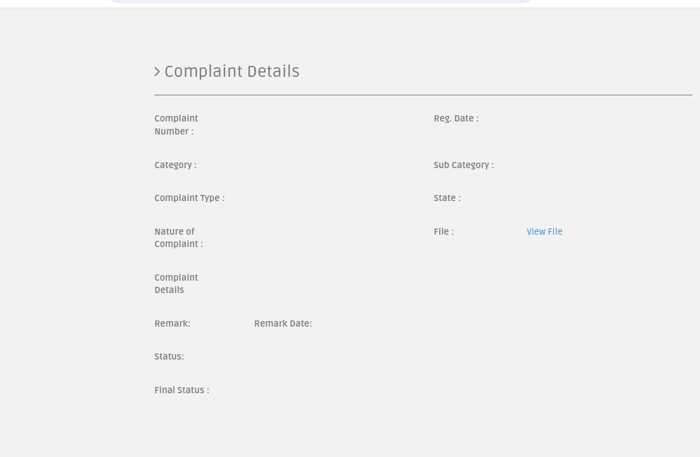
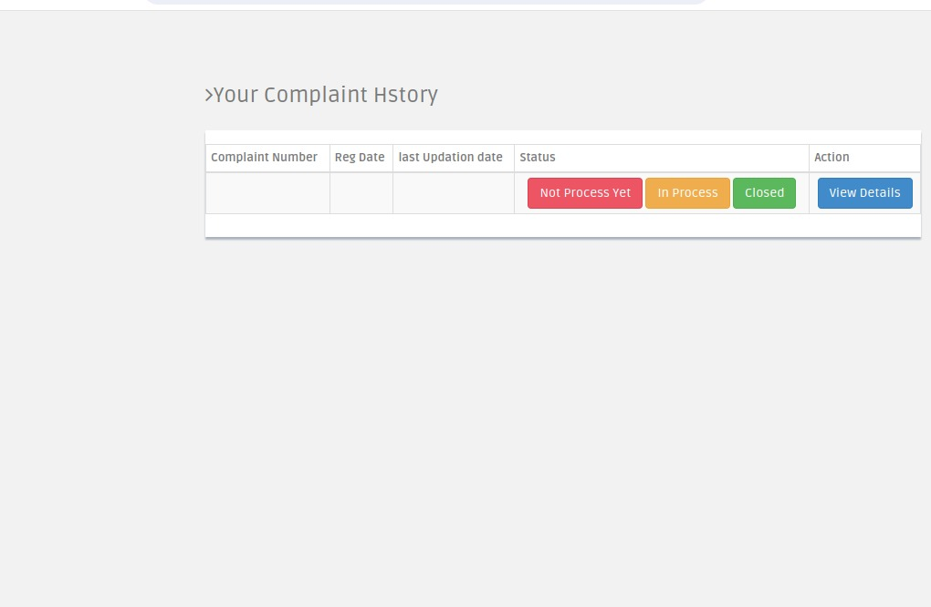
COMPLAINT DETAIL $COMLAINT HISTORY:

Slide 7
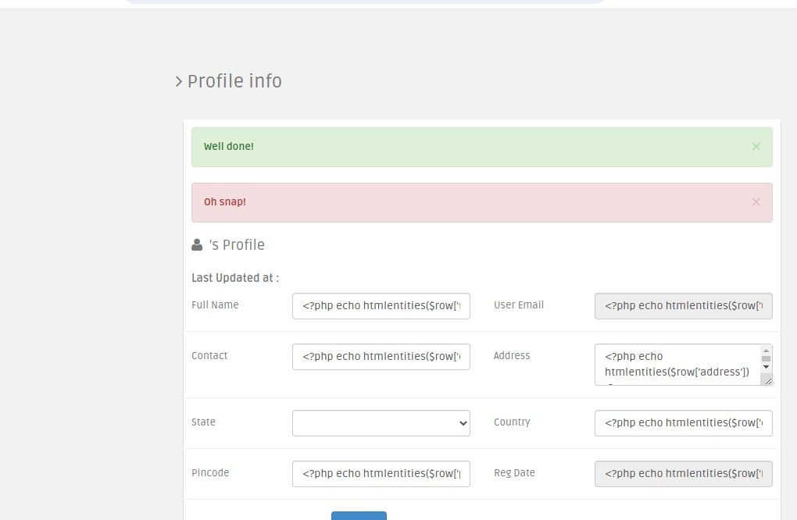
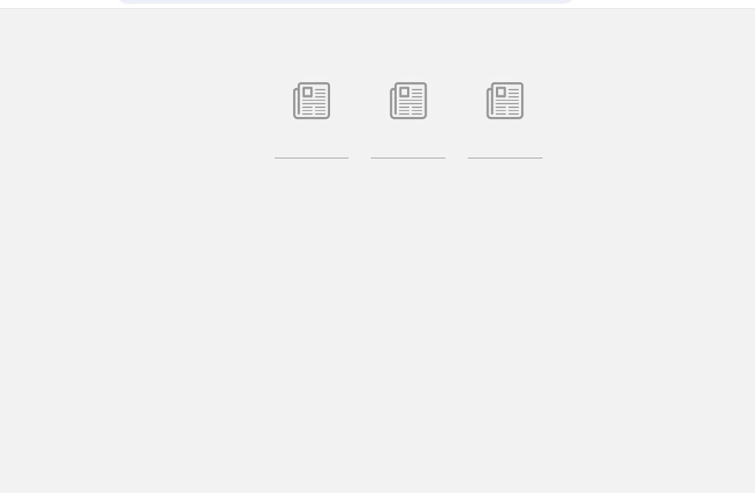
Profile &dashboard:

Slide 8
BACKEND: Admin table user table user login table complaint table

Slide 9
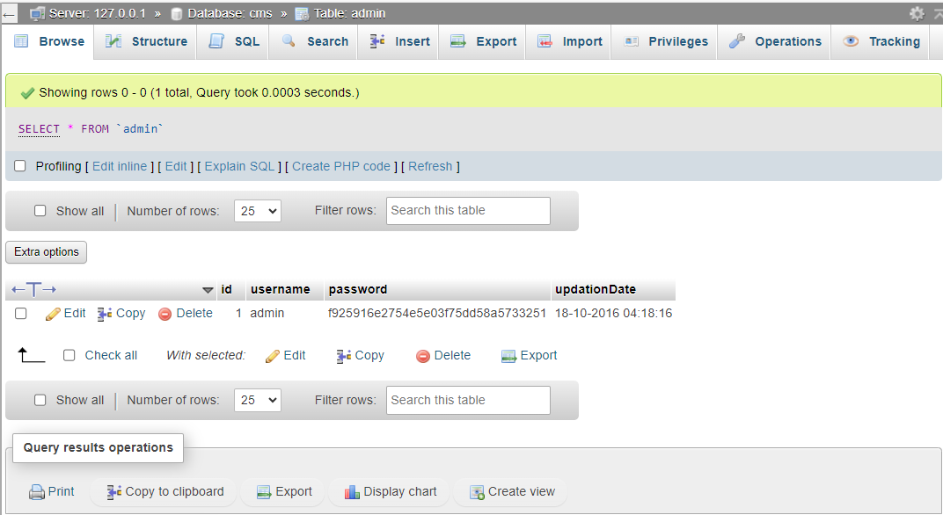
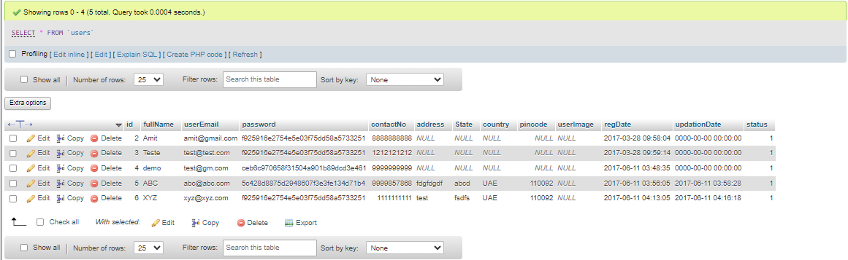

Slide 10
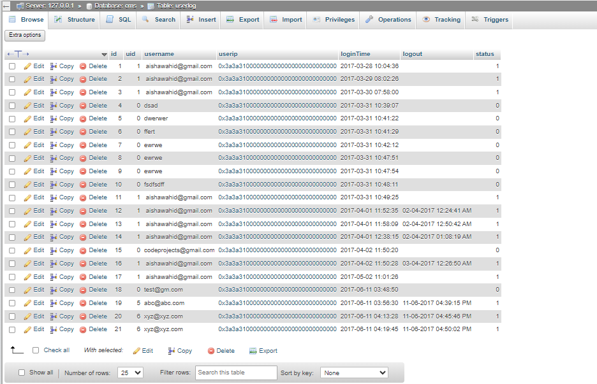
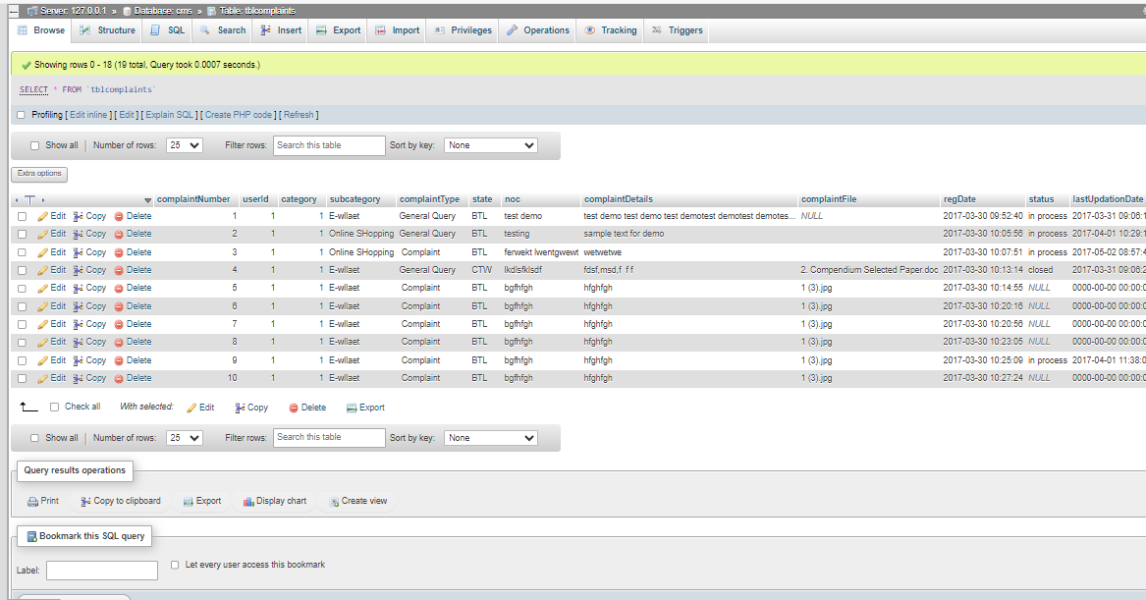

Slide 11
